Slide 1
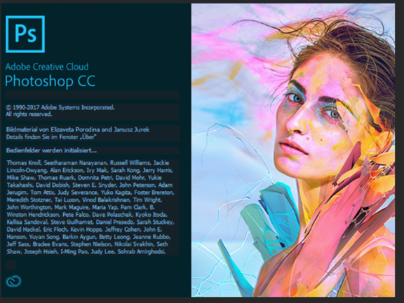
Project 1 – Who are you?
Two part project:
Sway Presentation
Photoshop #Selfie Poster
Sway Skills:
Creating a sway, google pictures, camera app, proper formatting, sharing
Photoshop skills:
Move, Magic Wand, colour selection Gradient, Text, Layers, Deselect, transform, fx, inserting images

Slide 2
Project 1: Who are You?
SWAY PRESENTATION
https://greve.schoolsites.ca/tech-6
You Must answer 20 of these questions
At least 10 pictures of you
At least 10 pictures from Bing or google
Title your project “All about ‘your name’
Copy and paste the question you are answering, type your answer and insert a corresponding image

Slide 3
SWAY 1

Slide 4
SWAY 2

Slide 5
SWAY 3

Slide 6
SWAY 4

