Slide 1
Tech 6
Senator Joyce Fairbairn middle school

Slide 2
Welcome to tech 6!
Here’s a quick guide to the projects we will be working on, as well as how you will showcase your work

Slide 3
Day one: make a Tech 6 Folder
Create a students’ shared tech 6 folder:
Open your file folder
This PC
Students shared J:drive
Open Tech 6
Right click, new folder
Type your first and last name
This will be the folder you use for all tech 6 files
File Management

Slide 4
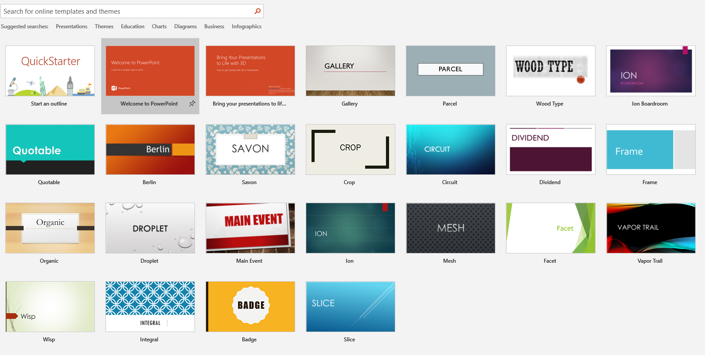
Day one: digital portfolio
Open Microsoft PowerPoint
Select a template you like
Title slide: “Tech 6 Digital Portfolio – Your Name
This is where you will showcase all your work
Digital portfolio

