Slide 1
Project 3: typingclub.com
Log in with office 365
Take the placement test
Take a screen shot of your level: “windows key-shift-S”
Type! Advance as far as you can
After 3 classes of typing, take a screen shot of your new level to show growth
Insert these images into your digital portfolio

Slide 2
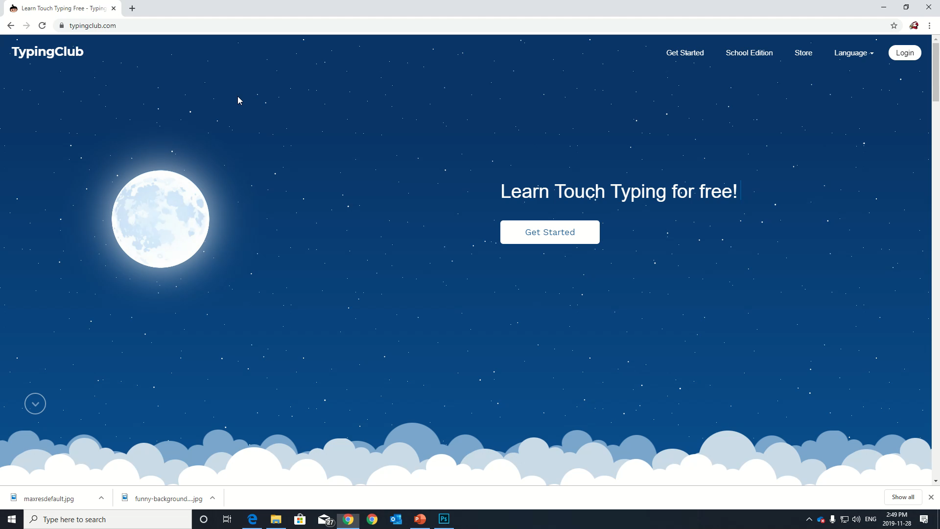
Project 3: typing club

Slide 3
Project 3: typingclub.com
TYPING CHALLENGE! ONE CLASS ONLY!
  Click “Placement Test”
  Take one placement test, then spend the rest of the class increasing your level
  the five students with the highest levels will claim a prize, along with the five most improved!

